Slide 1
Deep Learning for Finance Lab 2. Deep Learning + Python
Pablo-Manuel Calderón Gómez
2018

Slide 2
Deep Learning + Python
Index
The foreign exchange market
Process description.
Reading data.
Calculate the Inputs (X).
Define One-Hot encoding and calculate predictions.
Create the train and test windows.
Define the algorithms to use.
List of parameters
Results

Slide 3
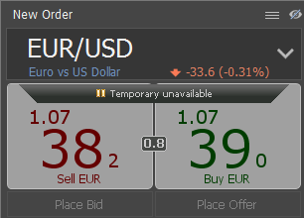
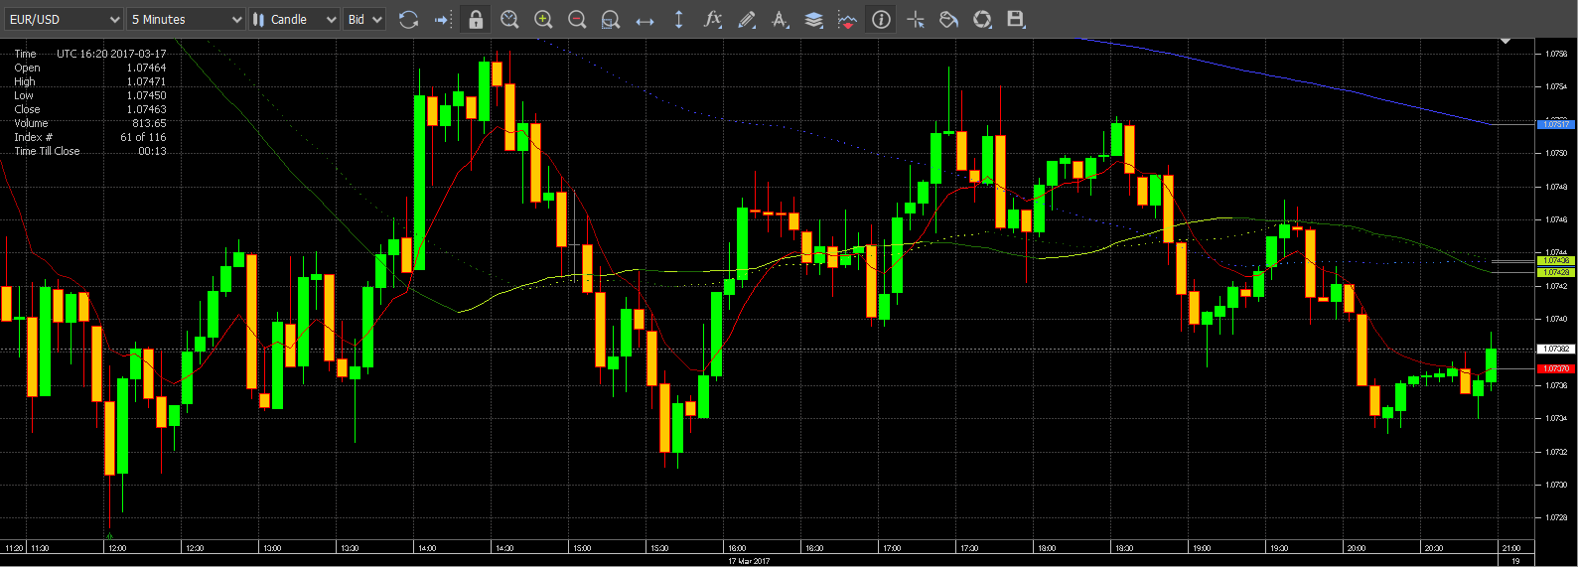
Deep Learning + Python
The foreign exchange market (Forex, FX, or currency market)
FOREX: is a global decentralized market for the trading of currencies.
The foreign exchange market is unique because of the following characteristics:
Its huge trading volume, representing the largest asset class in the world leading to high liquidity.
Its geographical dispersion.
Its continuous operation: 24 hours a day except weekends.
The use of leverage to enhance profit and loss margins and with respect to account size.
About 95% of the operations are purely speculative.
Buying price (BID), selling price (ASK).
It allows long and short operations.

Slide 4
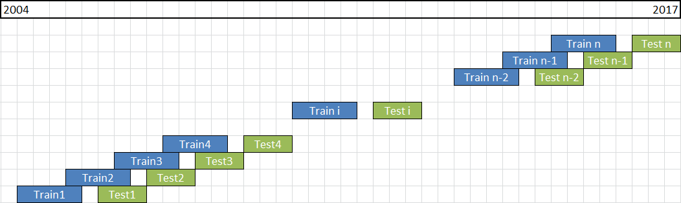
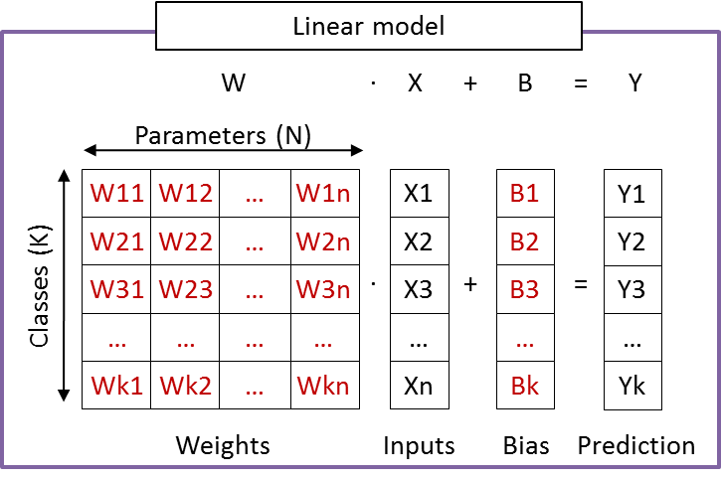
Deep Learning + Python
Process description
Read instrument data from csv file into dataframe.
Calculate the Inputs (X).
Define the One-Hot encoding.
Calculate the predictions (Y).
Create the train and test windows.
Define the algorithms to use.
Run the algorithms.
Calculate global results.
Data Frame
Inputs X
Predictions Y
CSV
t1
t2
t3
…
ti
…
tn
SMA 21
SMA 48
SMA…
SMA 192
EMA 21
EMA…
…
Y1
Y2
Y3
…
Yi
…
Yn
One-Hot encoding
1
0
0
0
0
1
0
0
0
0
1
0
0
0
0
1

Slide 5
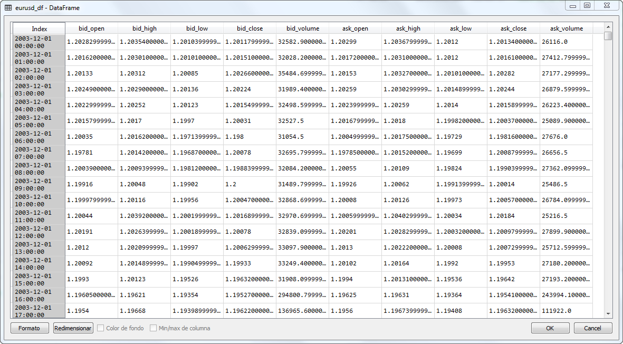
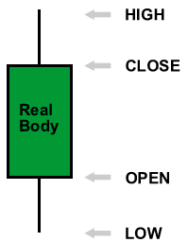
Deep Learning + Python
Reading data
In Python we use DataFrame objects (panda library) to store data.
DataFrame is a two-dimensional size-mutable, potentially heterogeneous tabular data structure with labelled axes (rows and columns).
The instrument csv file contains:
Columns: Open, high, low, close and volume for ask and bid.
Rows: periods (hourly, one-min, daily,…).

Slide 6
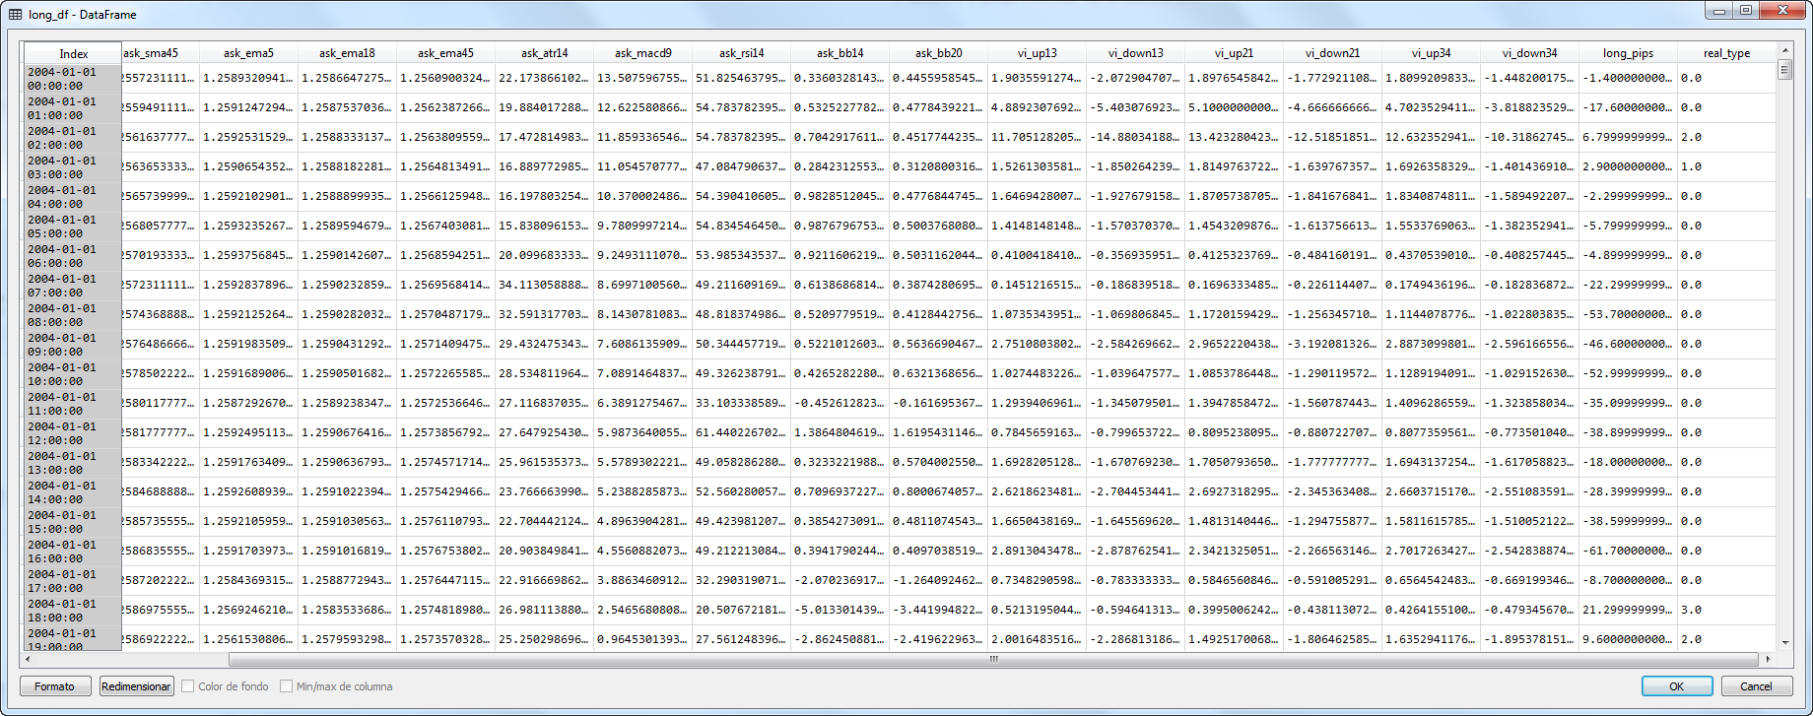
Deep Learning + Python
Calculate the Inputs (X)
We use close values of the instruments to calculate the inputs matrix.
Simple moving average (SMA).
Exponential moving average (EMA).
Average true range (ATR).
Moving average convergence/divergence (MACD).
Relative strength index (RSI).
Bollinger Bands (BB).
Vortex Indicator (VI).

Slide 7
Deep Learning + Python
Define One-Hot encoding
We use the one-hot encoding to define the classes. Each class will be unique and defined as a vector of zeros with only one 1.
In our analysis we define 2 classes depending on the profit in pips (r):
It can be defined any number of classes depending on the problem needs.
p<10
p>=10
1
0
0
1
0
1
p<0
0<p<=10
10<p<20
p>=20
1
0
0
0
0
1
0
0
0
0
1
0
0
0
0
1
0
1
2
3

Slide 8
Deep Learning + Python
Calculate the prediction – Strategy trend
One deal is open at close price of each candle.
The deal is active during a fix number of periods (“open_periods = 10”).
The deal is closed after the fixed number of periods at candle close price.
For the period defined we calculate the profit in pips for each deal.
Depending on the deal’s pips we assign a class type (0 or 1). Which are the predicted values (Y).

Slide 9
Deep Learning + Python
Calculate the prediction – Strategy fix TP and SL
One deal is open at close price of each candle.
The deal is active during a fix number of periods (“open_periods = 48”).
The deal is closed at stop loss level if pips are lower that SL.
The deal is closed at take profit level if pips are above TP.
The deal is closed after the fixed number of periods at candle close price.
For the period defined we calculate the profit in pips for each deal.
Depending on the deal’s pips we assign a class type (0 or 1). Which are the predicted values (Y).
TP (long)
SL (long)

Slide 10
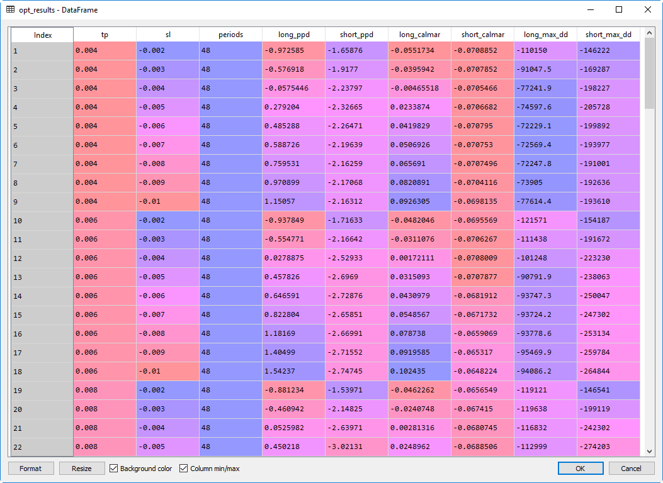
Deep Learning + Python
Strategy fix TP and SL
We need to define take profit, stop loss and number of periods for the strategy.
Optimization: the parameters are selected based on calmar and ppd.

Slide 11
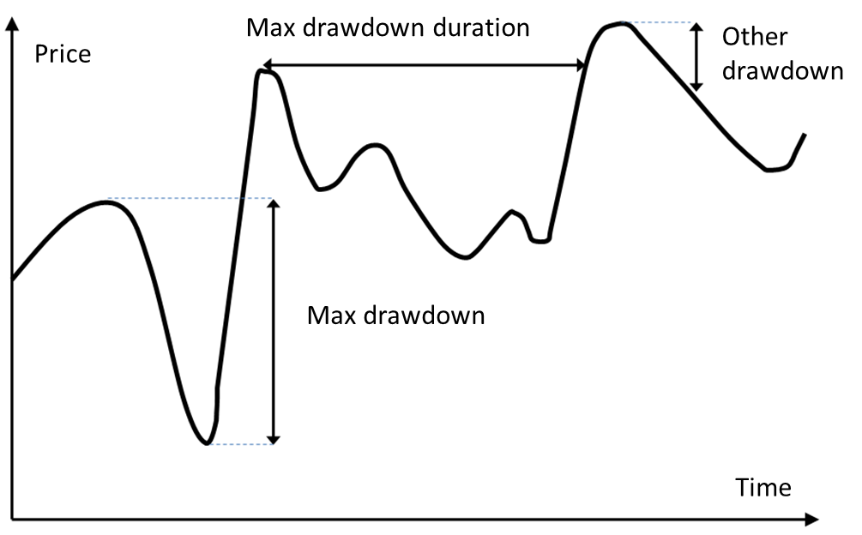
Deep Learning + Python
Draw Down
A drawdown at given time t is defined as the difference between the current portfolio value and the global maximum of the portfolio value occurring before time t.
A drawdown of 20% requires a 25% return, while a 50% drawdown requires a whopping 100% increase to recover the same position.

Slide 12
Deep Learning + Python
Calmar ratio (or drawdown ratio)
Ref: https://en.wikipedia.org/wiki/Calmar_ratio
Calmar ratio (or Drawdown ratio) is a performance measurement used to evaluate Commodity Trading Advisors and hedge funds. It was created by Terry W. Young and first published in 1991 in the trade journal Futures.
Young defined it thus:
“The Calmar ratio uses a slightly modified Sterling ratio - average annual rate of return for the last 36 months divided by the maximum drawdown for the last 36 months - and calculates it on a monthly basis, instead of the Sterling ratio's yearly basis.”
In our Forex example the Calmar is calculated:
Calmar = Total profit pips / Maximum drawdown / number years

Slide 13
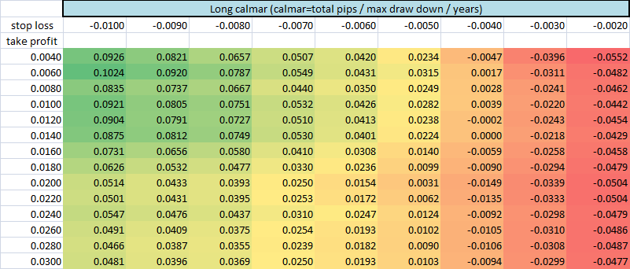
Deep Learning + Python
Parameters selected
The pivot table shows the calmar for long deals (period of 48hours):
We select TP=140, SL=-80.

Slide 14
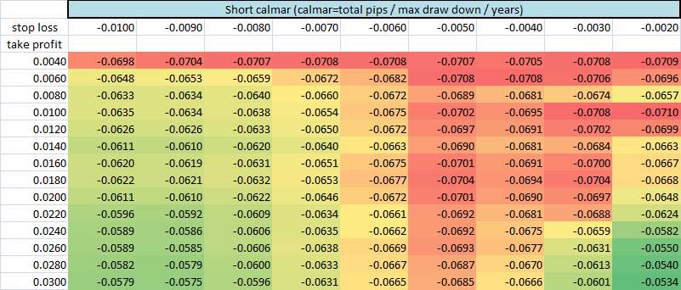
Deep Learning + Python
Parameters selected
The pivot table shows the calmar for short deals (period of 48hours):
We will keep long selection TP=140, SL=-80 to simplify example, but we can select any other combination with better calmar.

Slide 15
Deep Learning + Python
Create the train and test windows
We create a class (Window_model) which stores test data and train data into DataFrames.
Define the train size and the test size.
Go through the entire data set and create multiple Window_model instances. As a result the test DataFrames will cover the entire dataset.
Add each Window_model instance into an array list.
Note: it should be a gap between train and test to secure we do not use “future” data.
class Window_model
Vars:
model_id
DataFrame train_data
DataFrame test_data
Functions:
info
get...

Slide 16
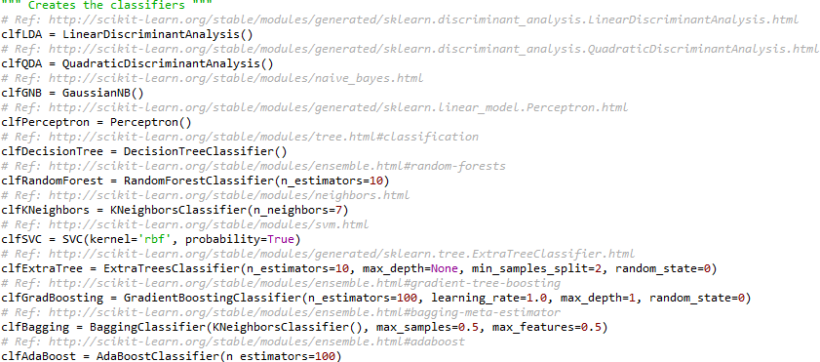
Deep Learning + Python
Define the algorithms to use
We select multiple classification algorithms:
LinearDiscriminantAnalysis
QuadraticDiscriminantAnalysis
GaussianNB
Perceptron
DecisionTreeClassifier
RandomForestClassifier
KNeighborsClassifier
SVC (Support Vector Machines)
ExtraTreeClassifier
GradientBoostingClassifier
BaggingClassifier
AdaBoostClassifier

Slide 17
Deep Learning + Python
List of parameters
We can tune 6 parameters for the analysis.
The example uses two categories, if we define more categories the one hot encoding parameters will be increased.
The open periods of the one hot encoding must be equal or bigger than the strategy periods to allow the production deployment of the strategy.
Origin | Parameter | Example Value
Strategy | Take profit | 140 pips
 | Stop loss | -80 pips
 | Open periods* | 48 periods
One hot encoding | Open periods* | 48 periods
 | Type data pips | 10 pips
Window | trainSize | 1440 periods
 | testSize | 120 periods

Slide 18
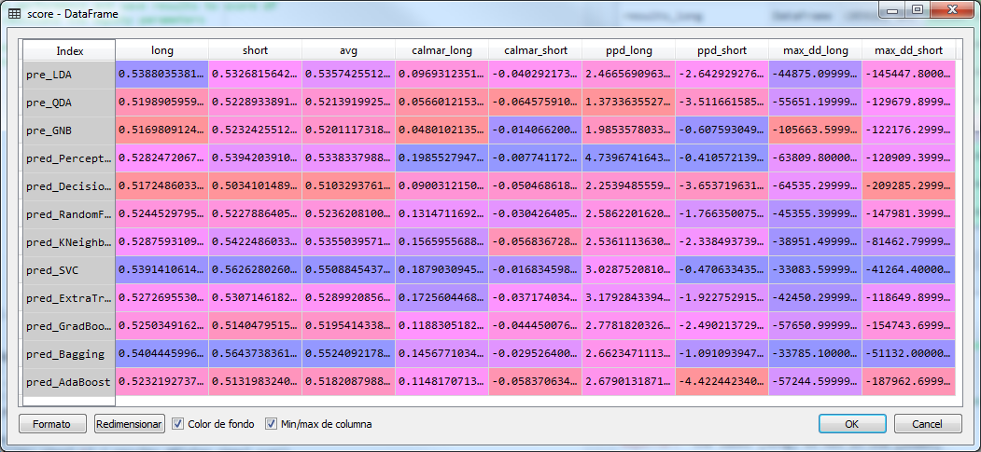
Deep Learning + Python
Results
The table shows the accuracy of the algorithms (ratio of correct predictions), calmar, pips per deal and maximum draw down.

Slide 19
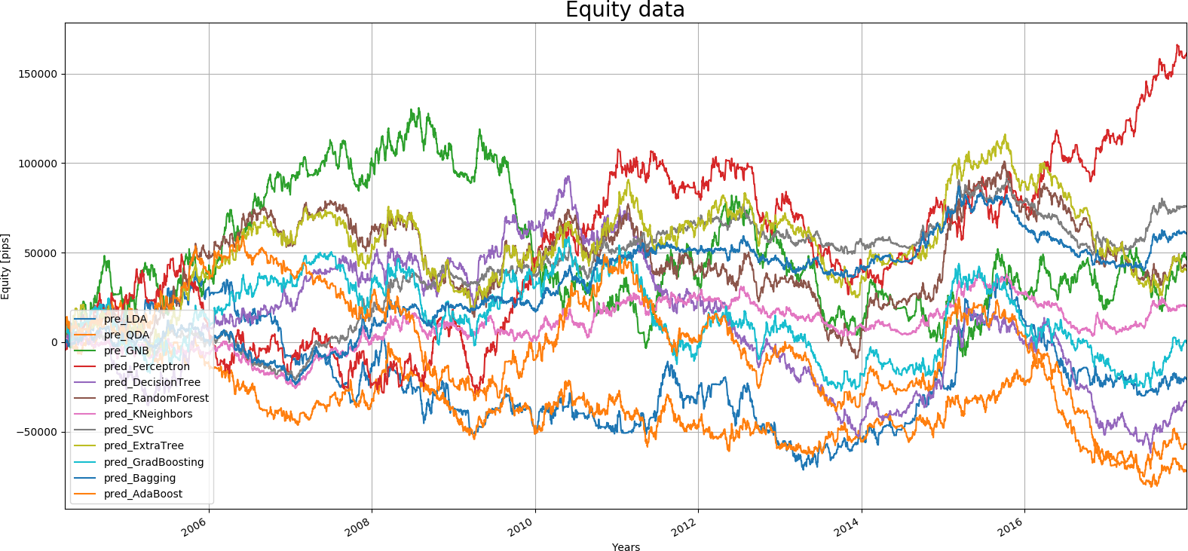
Deep Learning + Python
Results
The graph shows the total equity lines (long + short) for each of the algorithms.
trainSize=1440, testSize=120

Slide 20
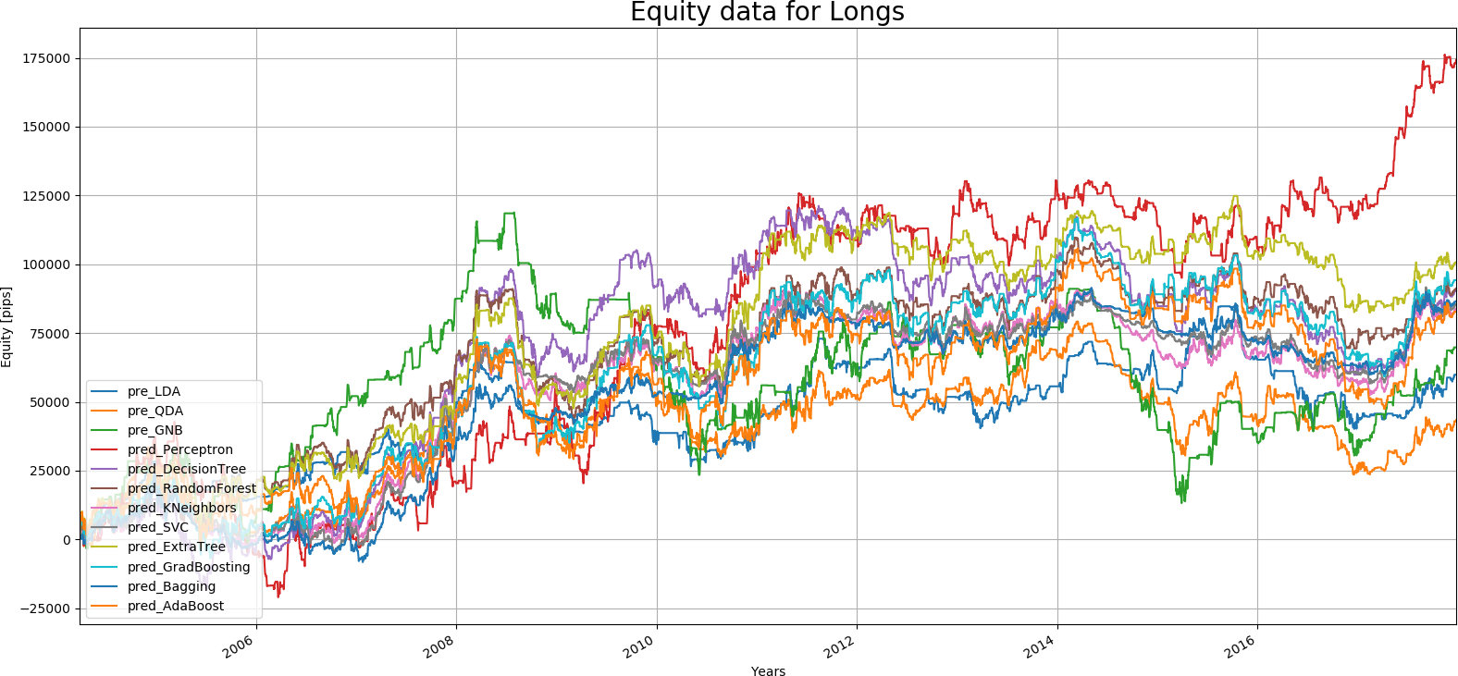
Deep Learning + Python
Results
The graph shows the long equity lines for each of the algorithms.
trainSize=1440, testSize=120

Slide 21
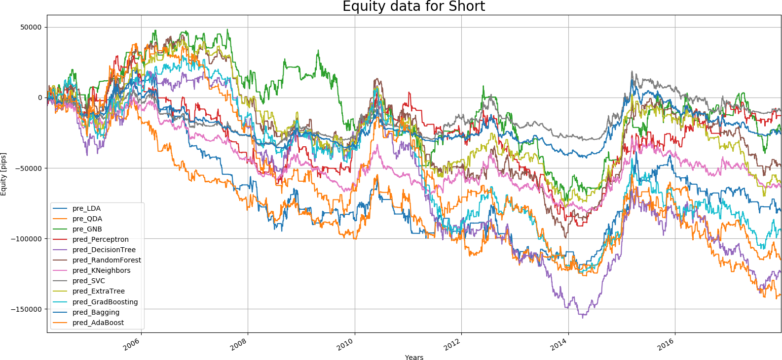
Deep Learning + Python
Results
The graph shows the short equity lines for each of the algorithms.
trainSize=1440, testSize=120

Slide 22
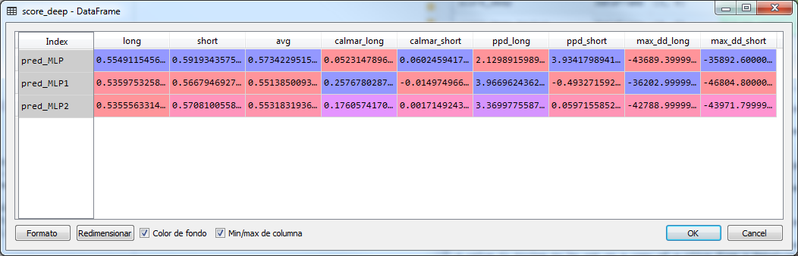
Deep Learning + Python
Results
The table shows the Multi-Layer Perceptron results: accuracy of the algorithms (ratio of correct predictions), calmar, pips per deal and maximum draw down.
clfMLP: hidden layer sizes=(10, 10, 10, 10, 10, 10, 10, 10, 10, 10)
clfMLP1: hidden layer sizes=(50, 50, 50, 50, 50, 50, 50, 50, 50, 50)
clfMLP2: hidden layer sizes=(50, 50)

Slide 23
Deep Learning + Python
Results
The table shows the results improvement using Machine Learning prediction.
*Multi-layer Perceptron of 10 layers with 10 nodes per layer for Long and 50 nodes per layer for shorts.
 |  | No Machine Learning | SVC Support Vector Machine classifier | Multi-layer Perceptron classifier*
Calmar | Long | 0.0749 | 0.1879 | 0.258
 | Short | -0.062 | -0.0168 | 0.060
Pips per deal | Long | 1.46 | 3.03 | 3.97
 | Short | -3.14 | -0.47 | 3.93
Max Drawdown | Long | -121597 | -33084 | -36202
 | Short | -297201 | -41264 | -35892

Slide 24
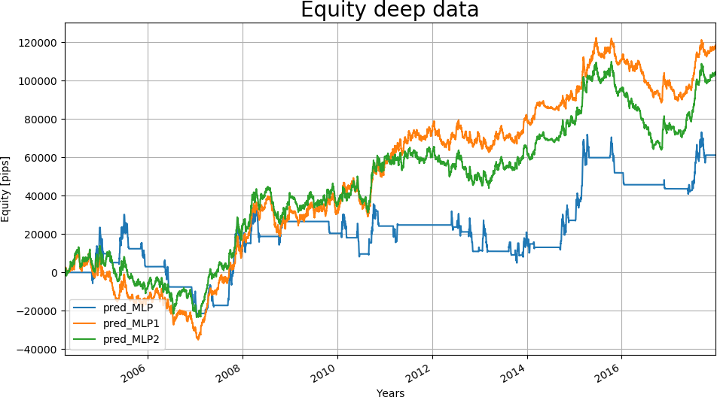
Deep Learning + Python
Results
The graph shows the total equity lines (long + short) for the Neural Networks.
trainSize=1440, testSize=120, gap=48

Slide 25
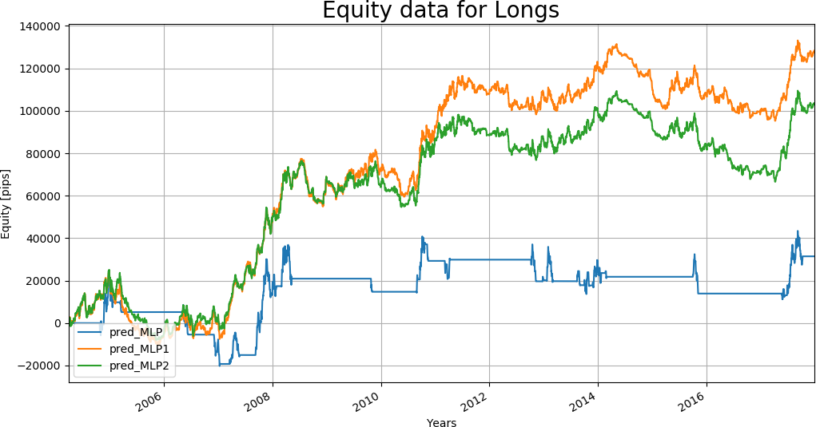
Deep Learning + Python
Results
The graph shows the long equity lines for the Neural Networks.
trainSize=1440, testSize=120, gap=48

Slide 26
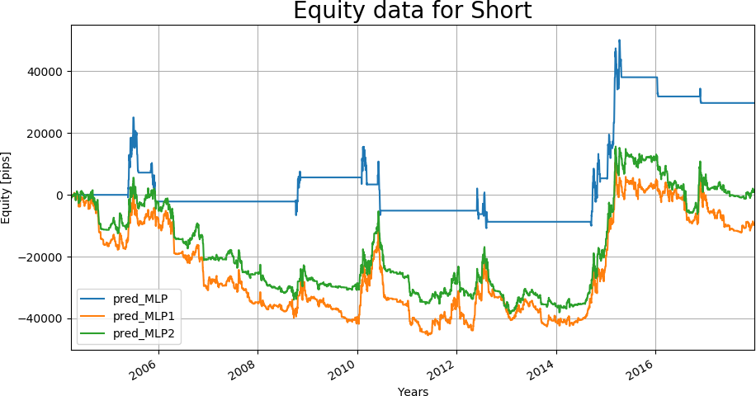
Deep Learning + Python
Results
The graph shows the short equity lines for the Neural Networks.
trainSize=1440, testSize=120, gap=48

Slide 27
Deep Learning + Python
Appendix
Confusion matrix
 |  | True condition
 |  | 1 | 0
Predicted class | 1 | True positives | False positives
 | 0 | False negatives | True negatives

